Slide 1

A Project On Rain Fall Detection Using Data Mining Techniques
Under the guidance of
Mrs.K.Srilakshmi, M.Tech
Assistant Professor, Department of CSE
Presented by
B.Arka Phanitha(15481A0520)
D.Radha Ramya Krishna(15481A0555)
D.Sai Mahesh(15481A0551)
N.Sai Prasad(16485A0503)

Slide 2
ABSTRACT
Rain Fall Detection is mainly concerned for predicting the rainfall using two algorithms(Data Mining Techniques). It provides critical information about future weather.Our application is about finding the accuracy for a data set by using two different data mining techniques.This respective data set is used for predicting rainfall by using its attributes such as Temperature, Humidity, Wind direction, Wind speed, Moisture etc. Naive Bayes, the classification algorithm used for predicting rainfall in probabilistic way which is simple and powerful. Another Data Mining technique is SVM(Support Vector Machine) ,supervised machine learning algorithm is a discriminative classifier formally defined by a separating hyperplane.

Slide 3
OBJECTIVES
The main objective of this system Rainfall Detection is to Predict Rainfall using two different Data Mining Techniques,
1.) Naïve Bayes Algorithm.
2.) SVM(Support Vector Machine) Algorithm.
Firstly, We load the raw Data Set that belongs to Sydney location.
This raw dataset is Pre-Processed and the Pre- Processed Data Set is Obtained.
Secondly, we extract the sensitive attributes/features that mostly effects the target variable.
Two types of Data sets are considered, Training Data set and Test Data set ,Now consider the training data set and apply classification algorithm.
Analyze and compare data with Year wise.
Finally, Finding the accuracy between the both algorithms that is Naïve Bayes and SVM(Support Vector Machine).

Slide 4
EXISTING SYSTEM
Government data sets use Artificial Intelligence techniques that is neutral networks these are Bayesian models and some other instruments like Thermometer for Air temperature, Anemometer for wind speed, Barometer for Air Pressure.
Weather is extremely difficult to forecast correctly. It is expensive to monitor so many variables from so many sources.
The computers needed to perform the millions of calculations necessary are expensive. The weather forecasters get blamed if the weather is different from the forecast.
Models sometimes misleads towards its bad side and hence can be harmful for the world. The atmosphere is a complex system. In fact we should describe it as chaotic.
Mathematically, this means that small changes at a point in time can lead to large changes much later in the forecast period. You may have heard of a butterfly flapping its wings in Brazil causing changes in the weather across the world, which is saying the same thing.

Slide 5
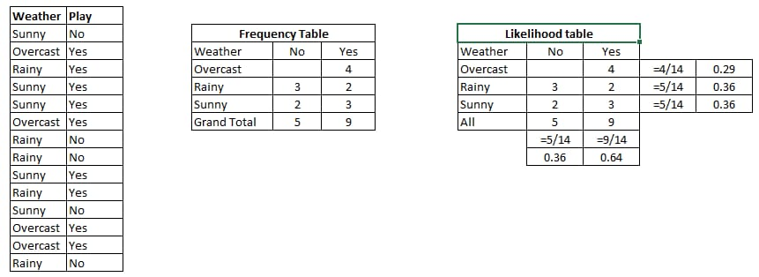
PROPOSED SYSTEM
Predicting Rainfall using Data Mining Techniques:
Naïve Bayes:
Simple Algorithm.
Generates results in probabilistic manner.
Formulae: P(H/E)=P(E/H).P(H)
P(E)
H= Hypothesis , P(H)= Hypothesis before getting evidence.
E=Evidence, P(H/E)= Hypothesis after getting evidence.
.

Slide 6
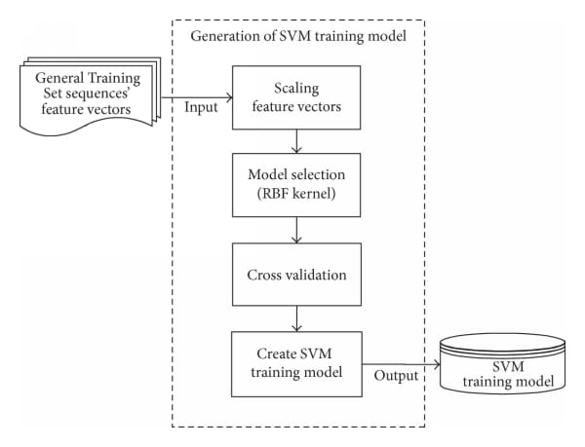
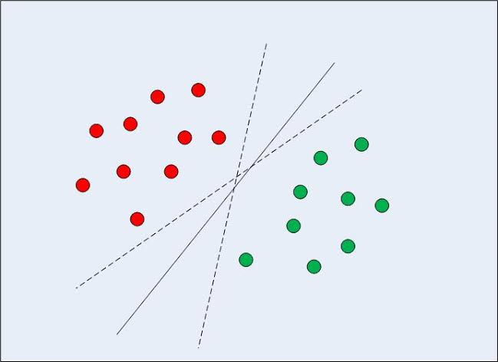
PROPOSED SYSTEM
SVM(Support Vector Machine):
Classifies data using hyper plane.
Used linear Kernel because it considers large number of features in Data sets

Slide 7
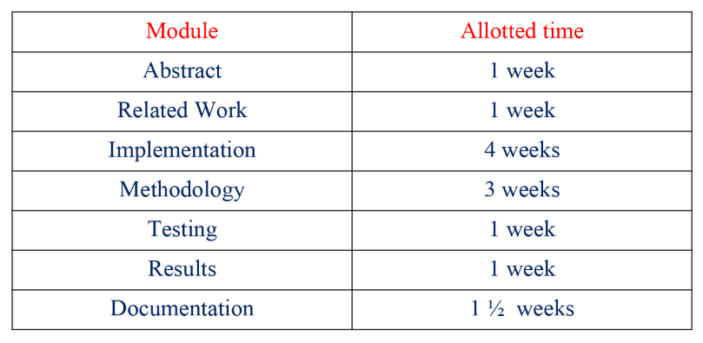
PLAN OF WORK

Slide 8
System Requirements
Hardware System Configurations
Processor - Pentium-IV or above
RAM - 4 GB
Hard Disk - 40 GB
Software Requirements:
Operating System - Windows 7 or later versions
Programming Language - Python
IDE - Pycharm

Slide 9
ARCHITECTURE DIAGRAM
M

Slide 10
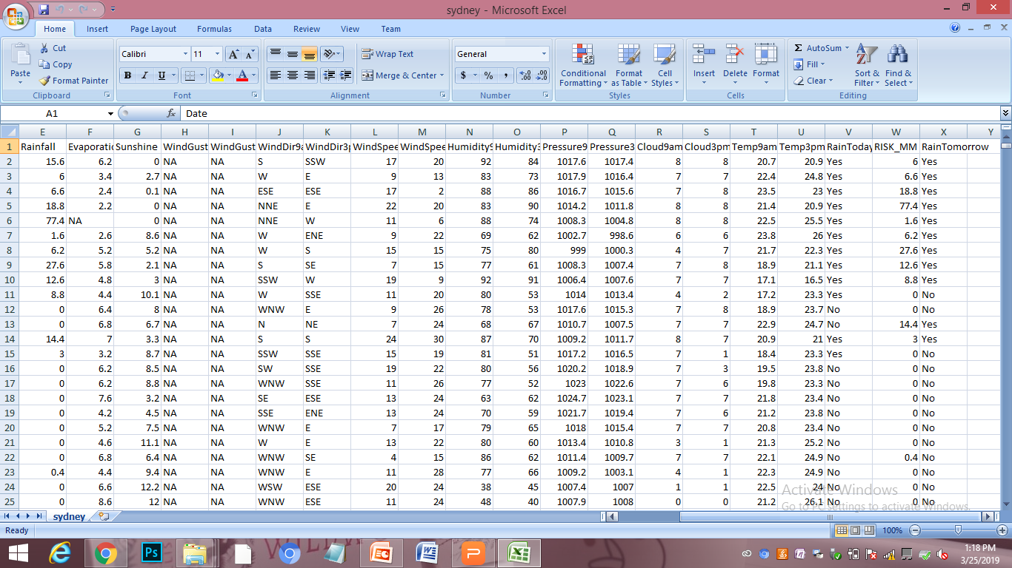
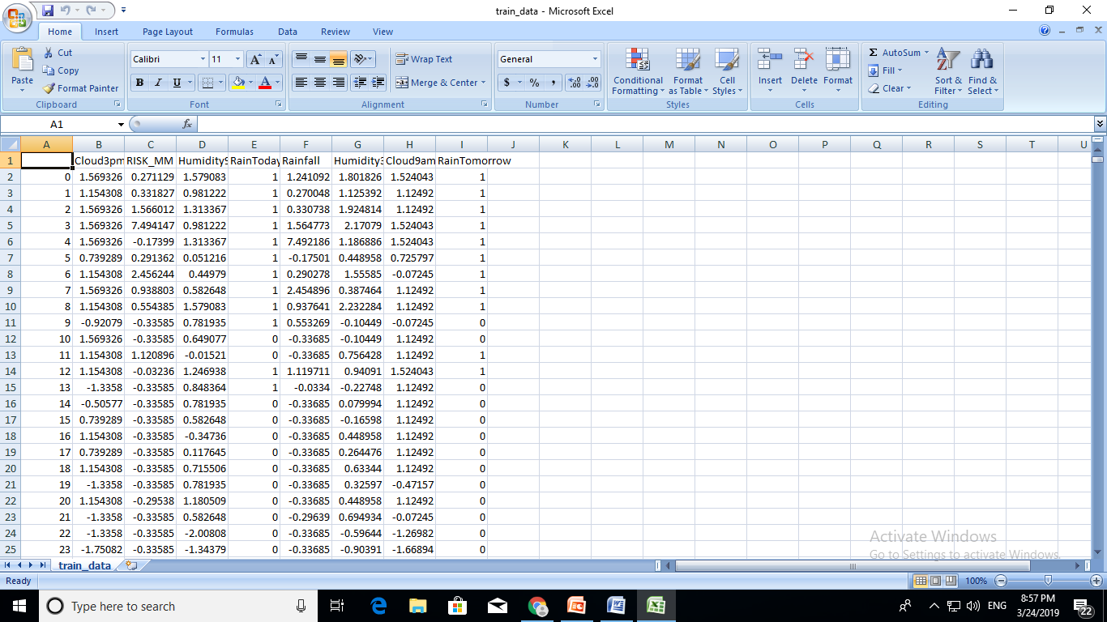
METHODOLOGY
The steps for processing data is as follows,
Loading the dataset
Pre Processing
Removing Null Values
Scaling
Encoding
Raw Data Set of Sydney
Data Set after Pre-Processing

Slide 11
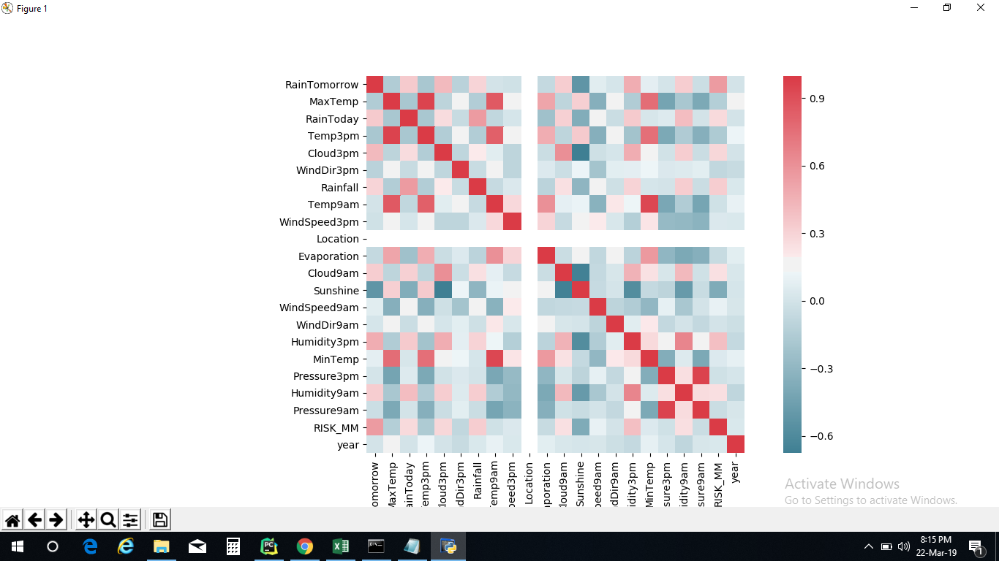
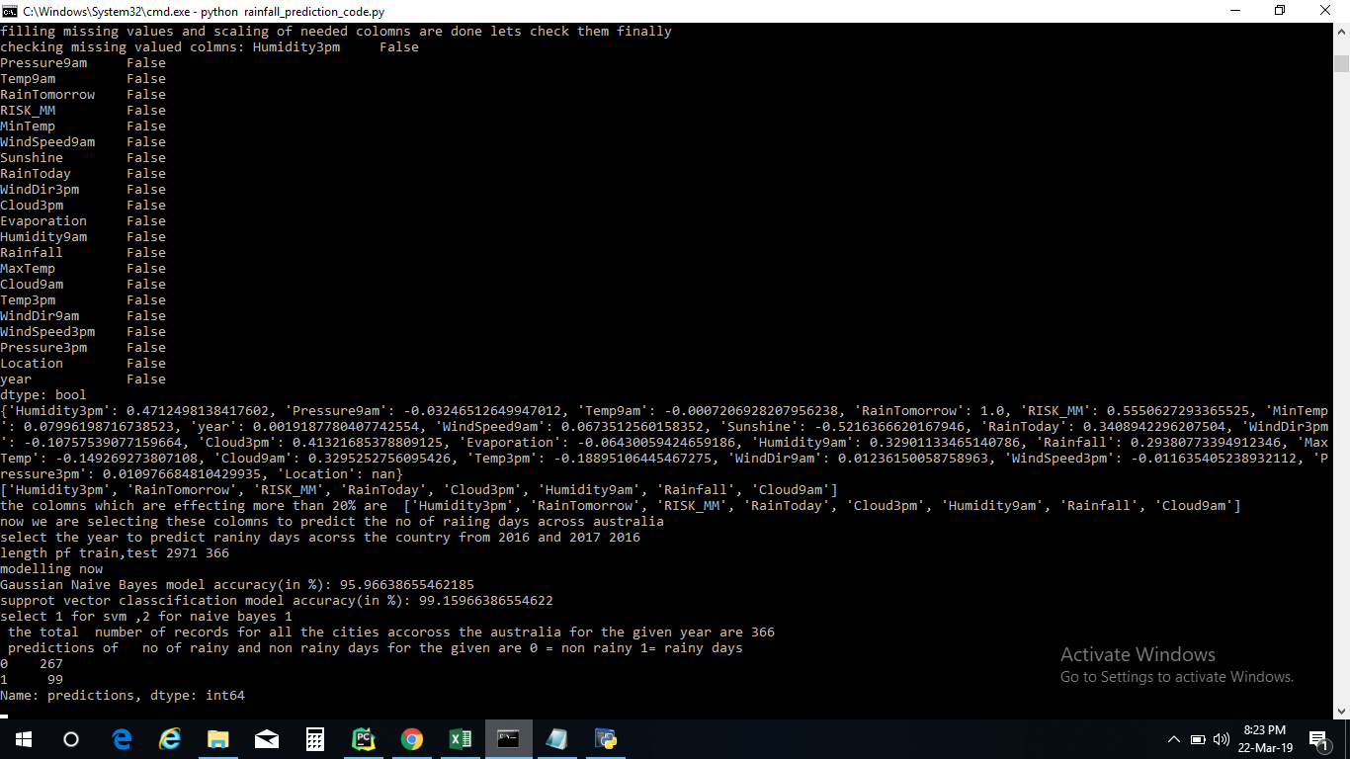
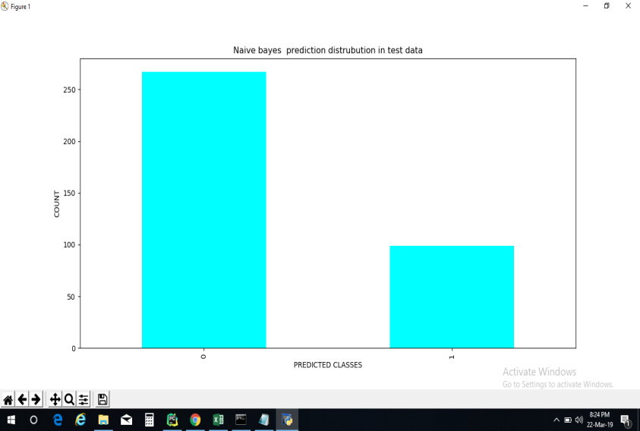
METHODOLOGY
Feature Selection
Modeling
Evaluating
Extracting Sensitive Attributes

Slide 12
METHODOLOGY
The raw data set we considered have 24 features and 3,338 rows. We considered 10 years of Data that is from 2008 to 2017.
“Rain Tomorrow” is our target variable.
As, 80% of data is considered as trained data and 20% as test data, we considered the data from 2008 to 2015 as trained data and we considered 2016 and 2017 as test data.
We use correlation classifier technique for obtaining sensitive features that effects in predicting the rainfall. The attributes we considered are,
Cloud 9am
Cloud 3pm
Humidity 9am
Humidity 3pm
Rain Today
Risk MM
Rainfall
Rain Tomorrow

Slide 13
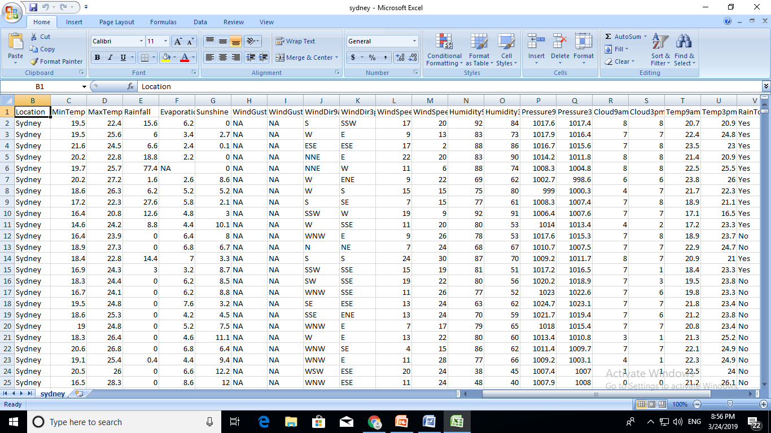
Implementation of the project

Slide 14
Raw Data Set Of Sydney

Slide 15
Trained Data Set

Slide 16
Sensitive Features Selection Graph
Sensitive Attributes
Unnecessary attributes

Slide 18

Naïve Bayes Result in Graphical Representation:

Slide 19
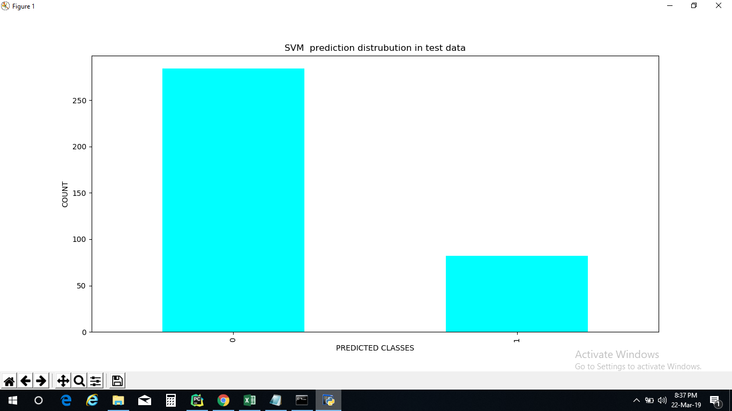
SVM Result in Graphical Representation:

Slide 20
CONCLUSION
SVM(Support Vector Machine) algorithm is accurate when compared with Naïve Bayes Algorithm.
SVM(Support Vector Machine) algorithm gives 99% Accuracy while Naïve Bayes algorithm gives 95.96% accuracy.
So, we conclude that SVM(Support Vector Machine) algorithm gives the best accuracy for predicting Rain Fall.

Slide 21


